Slide 1
Design, Manufacturing and Testing of a Hybrid Rocket Engine
UNH Students for the Exploration and Development of Space (SEDS)

Slide 2
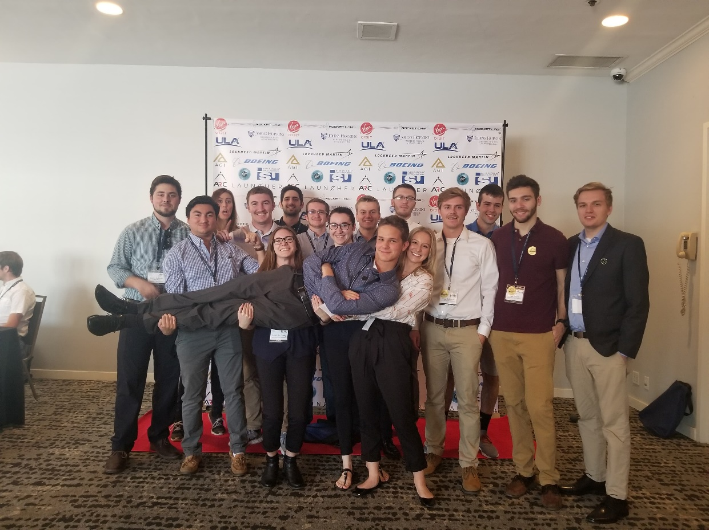
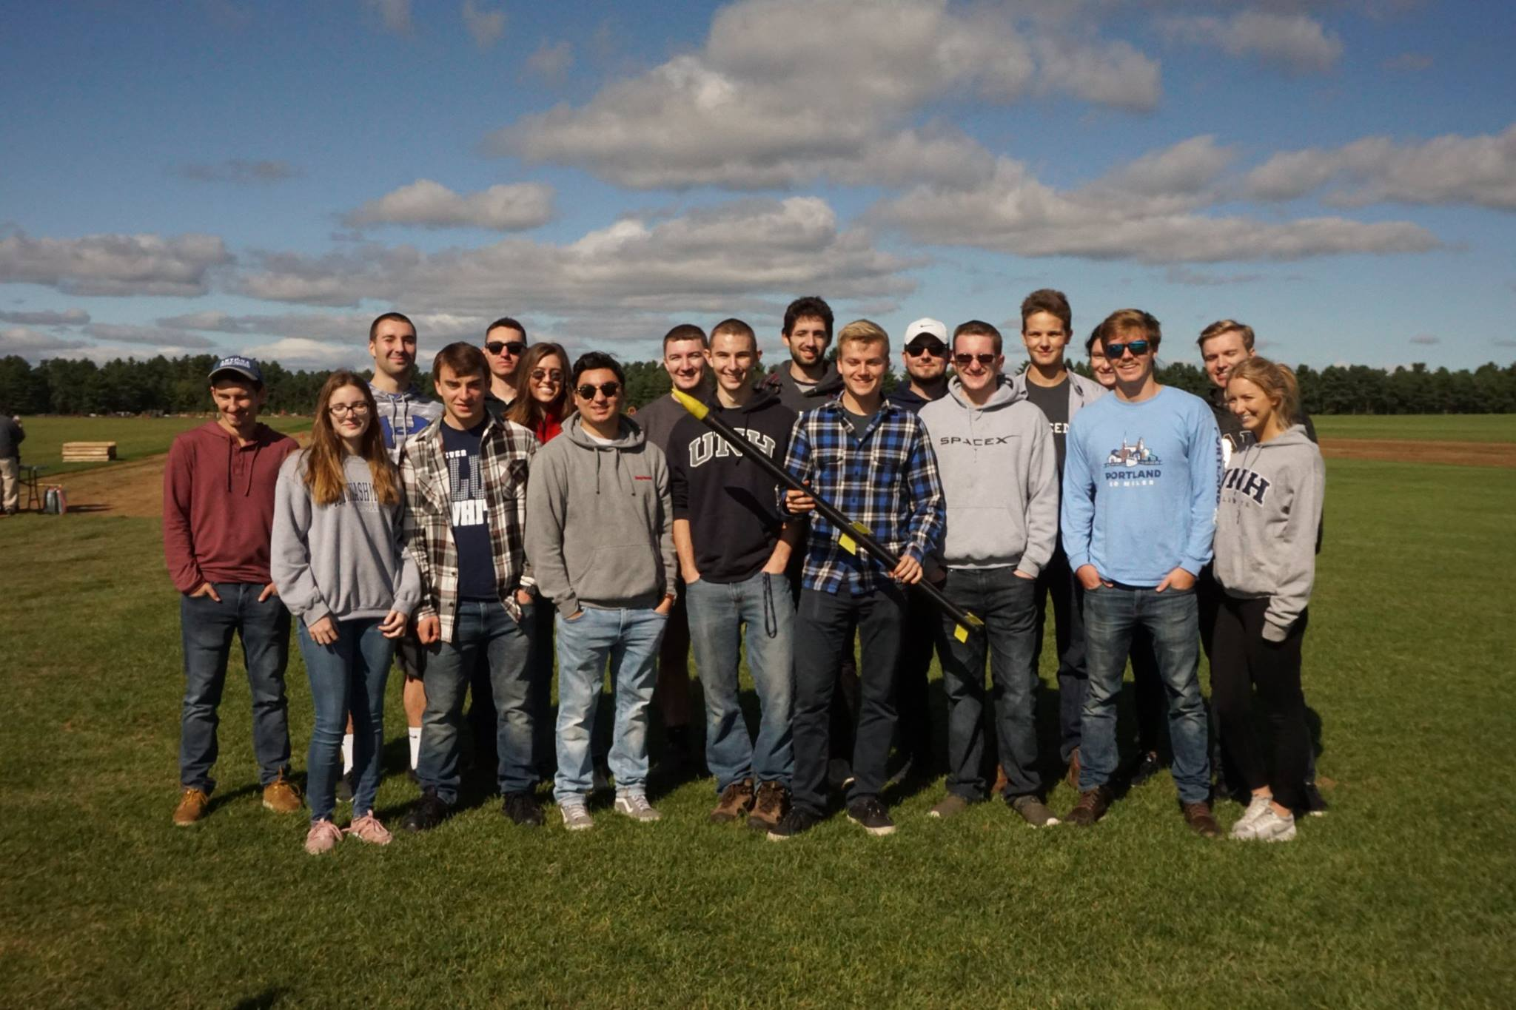
What is UNH SEDS?
A single chapter within a nationwide organization
Founded April 2017
Aerospace engineering organization within CEPS
Comprised of 25 passionate students of 6 different majors

Slide 3
My Vision
Year 1
2017-2018
Amateur Rocket Building Techniques
Year 2
2018-2019
Throttle Controlled Rocket Engine
Year 3
2019-2020
Competition Rocket for Spaceport

Slide 4
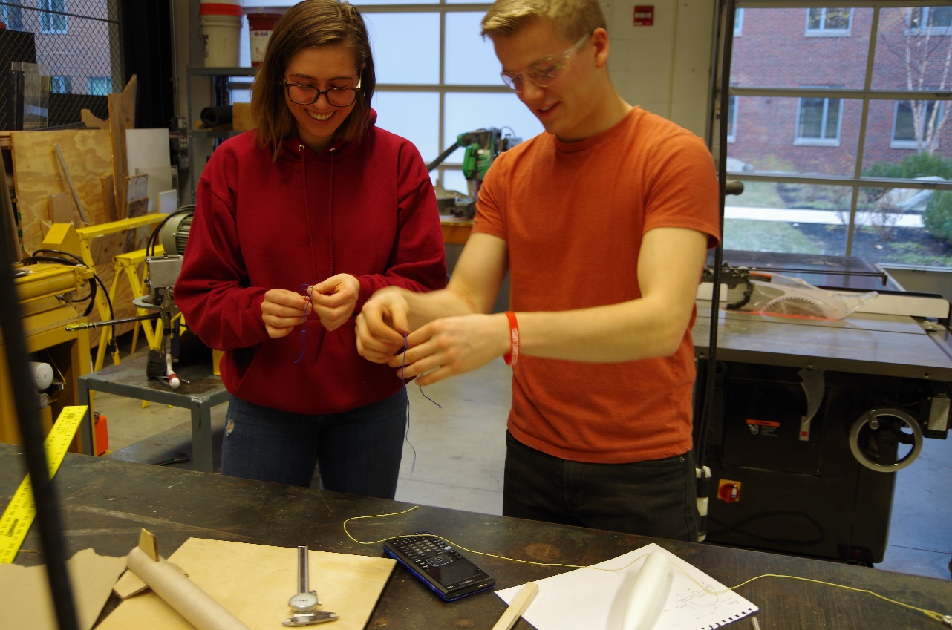
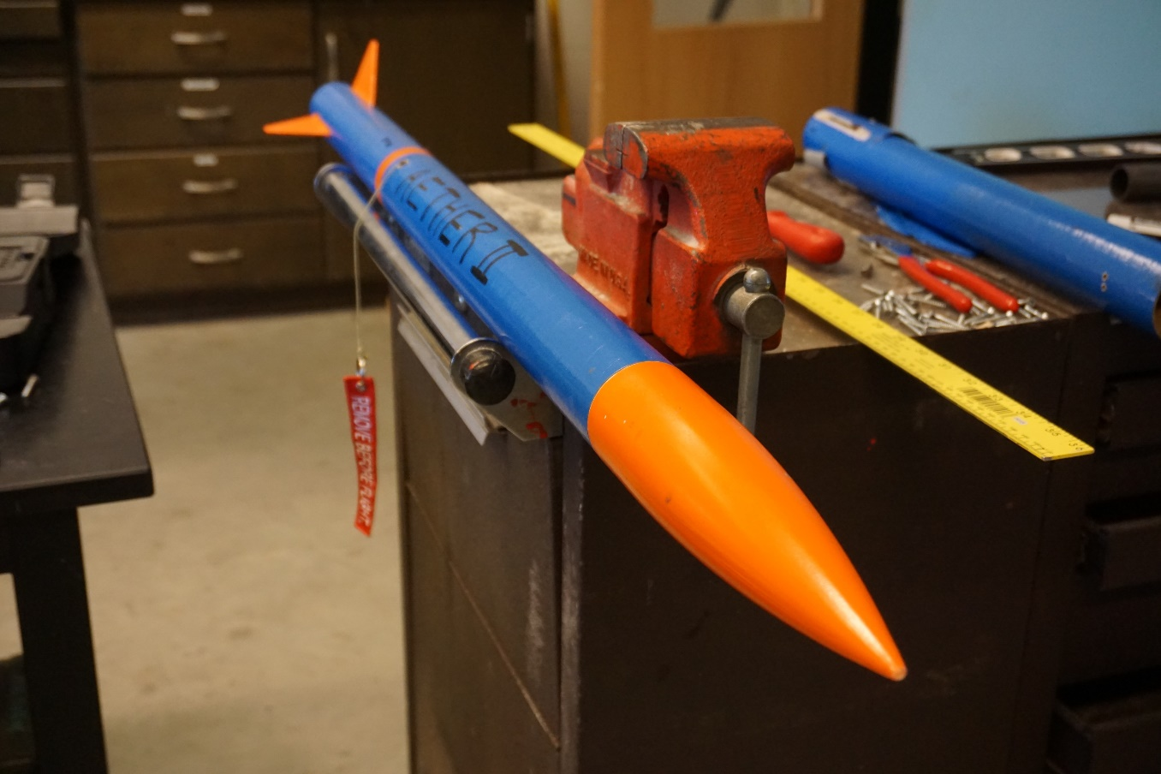
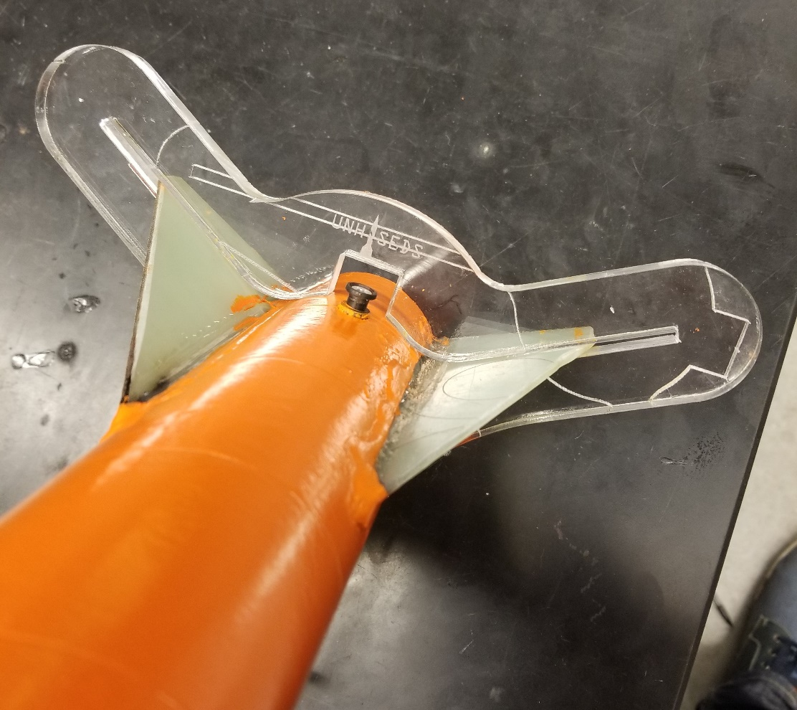
Year 1 Amateur Rocket Building Techniques Building Composite Rocket

Slide 5
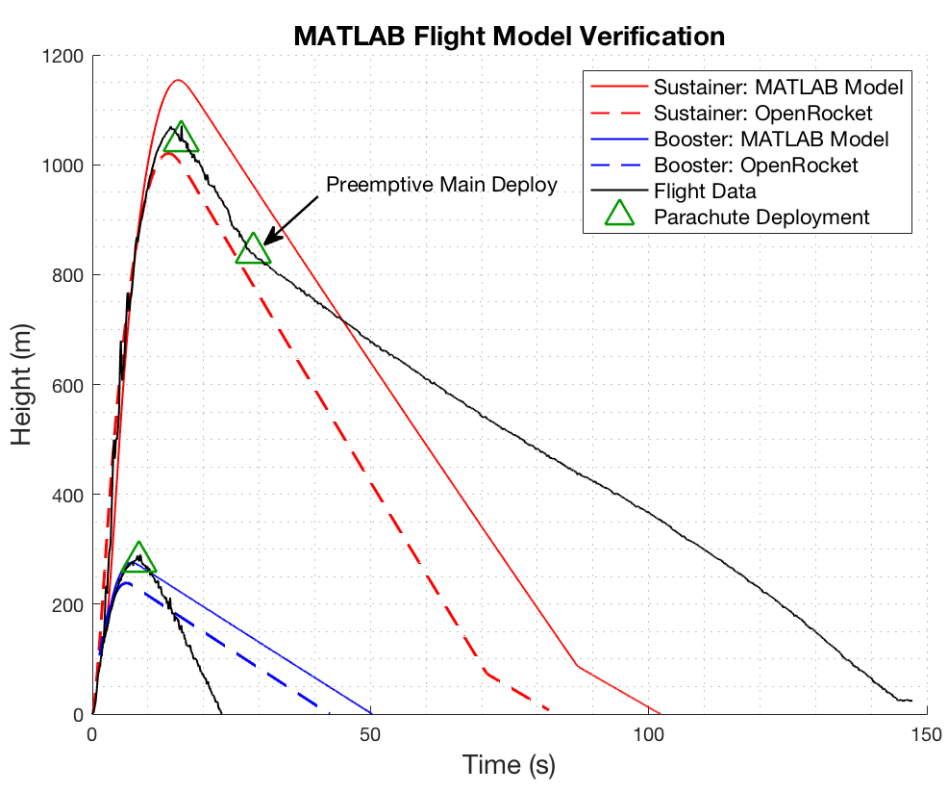
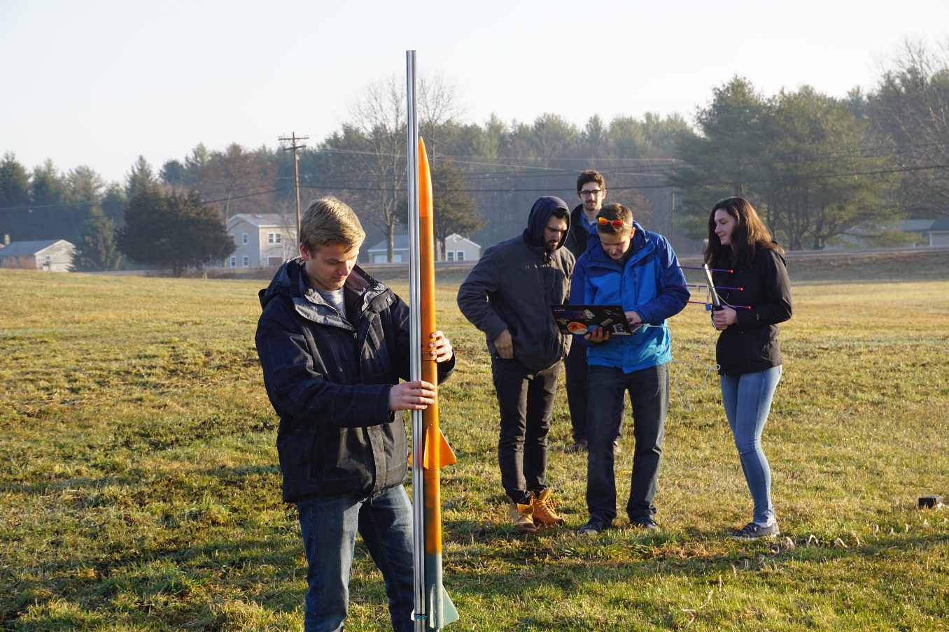
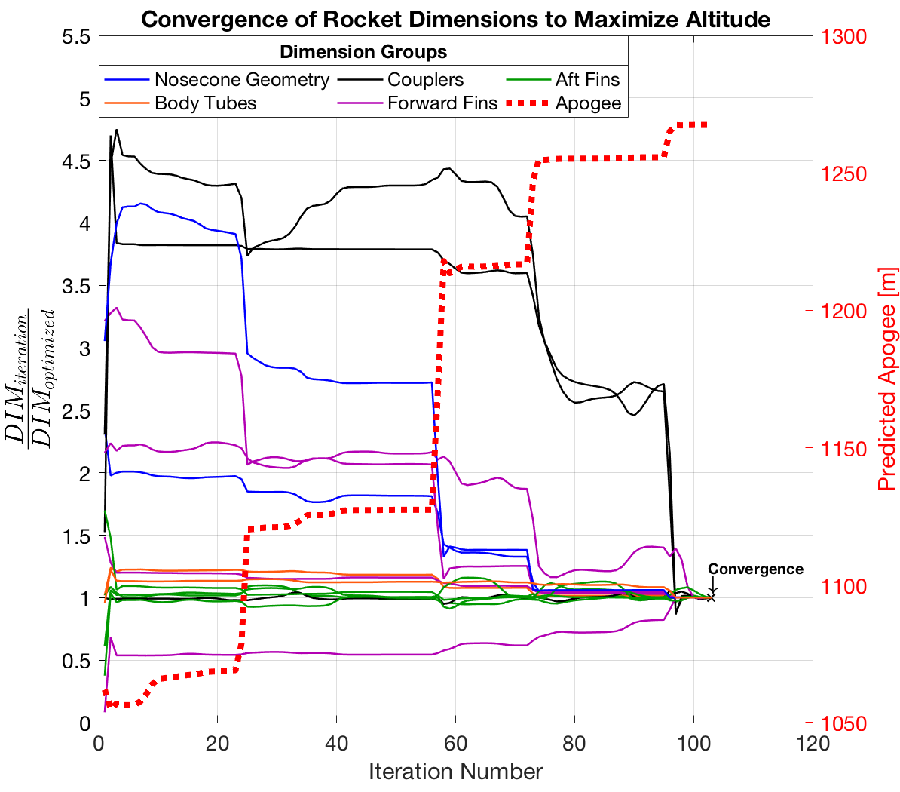
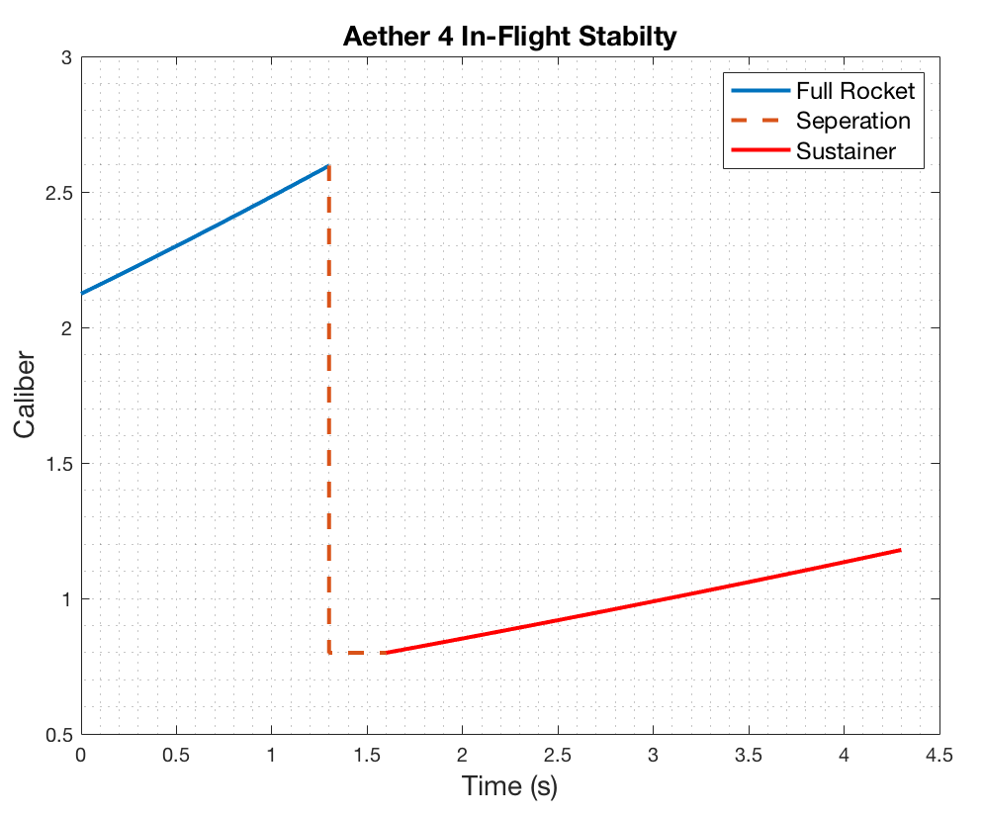
Year 1 Amateur Rocket Building Techniques Simulation and Testing

Slide 6
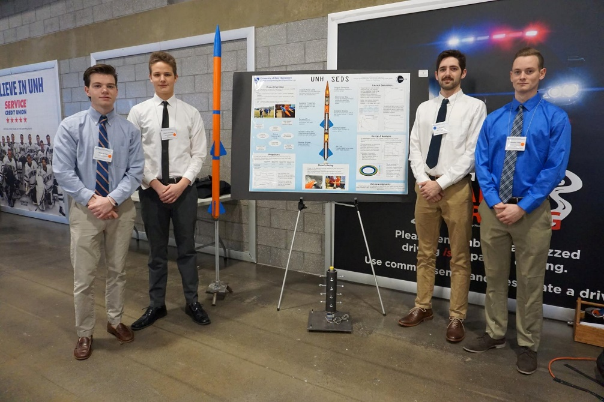
Year 1 Amateur Rocket Building Techniques Presentations and Awards

Slide 7
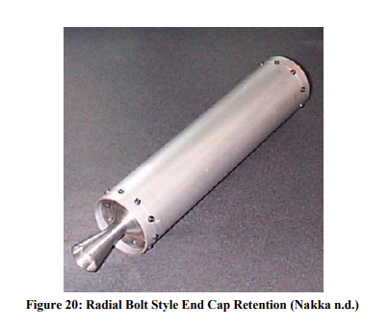

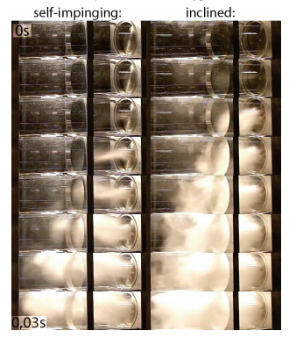
Year 2 Throttle Controlled Rocket Engine Research Literature

Slide 8
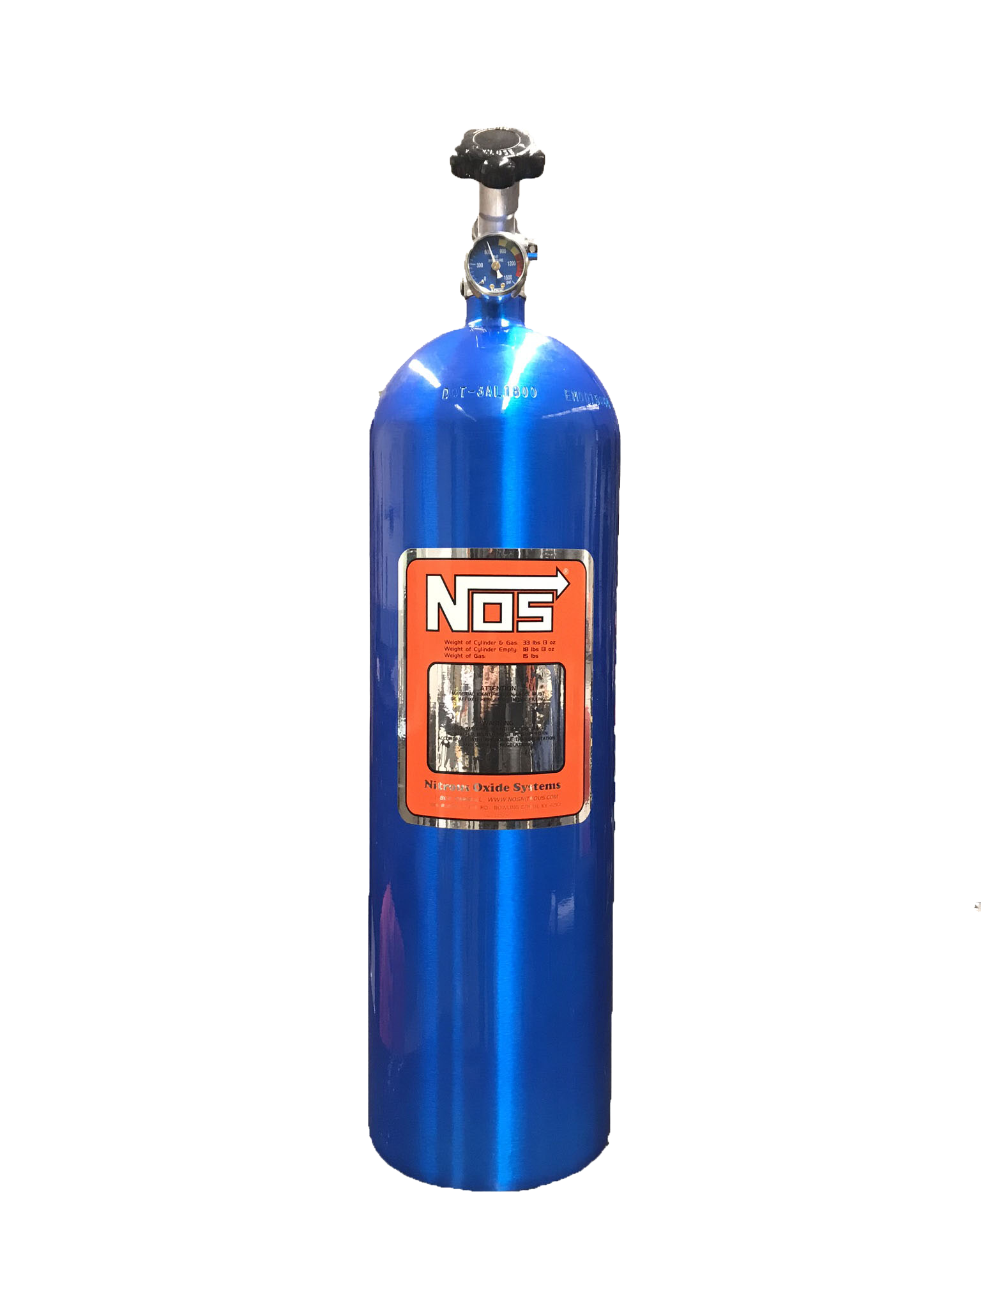
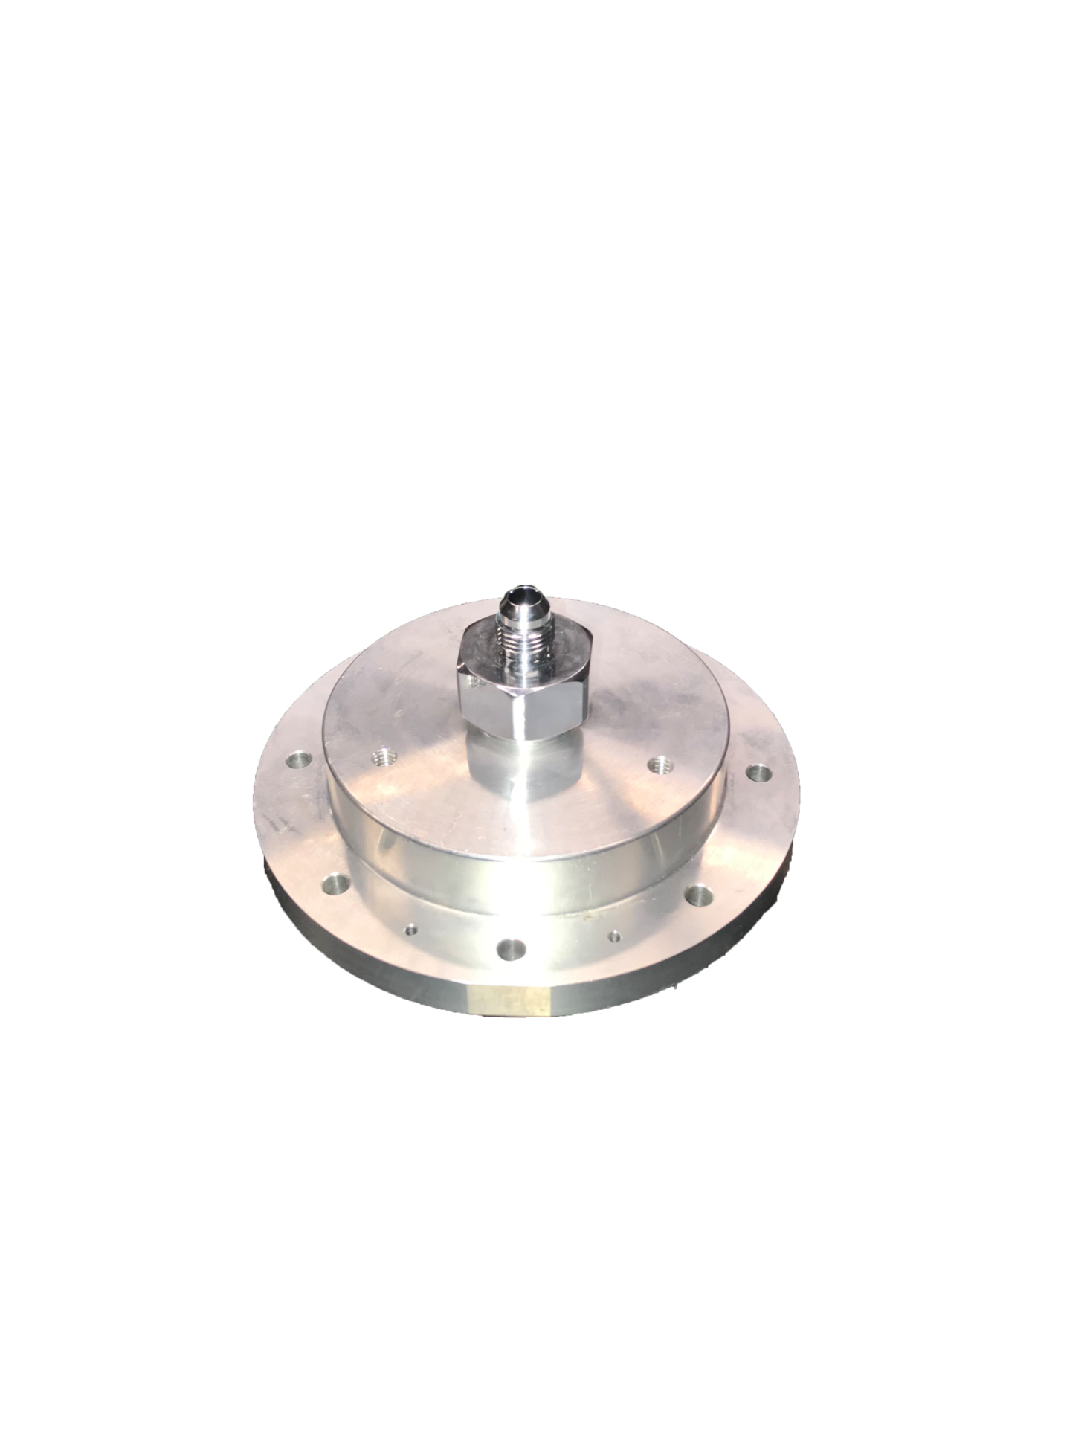
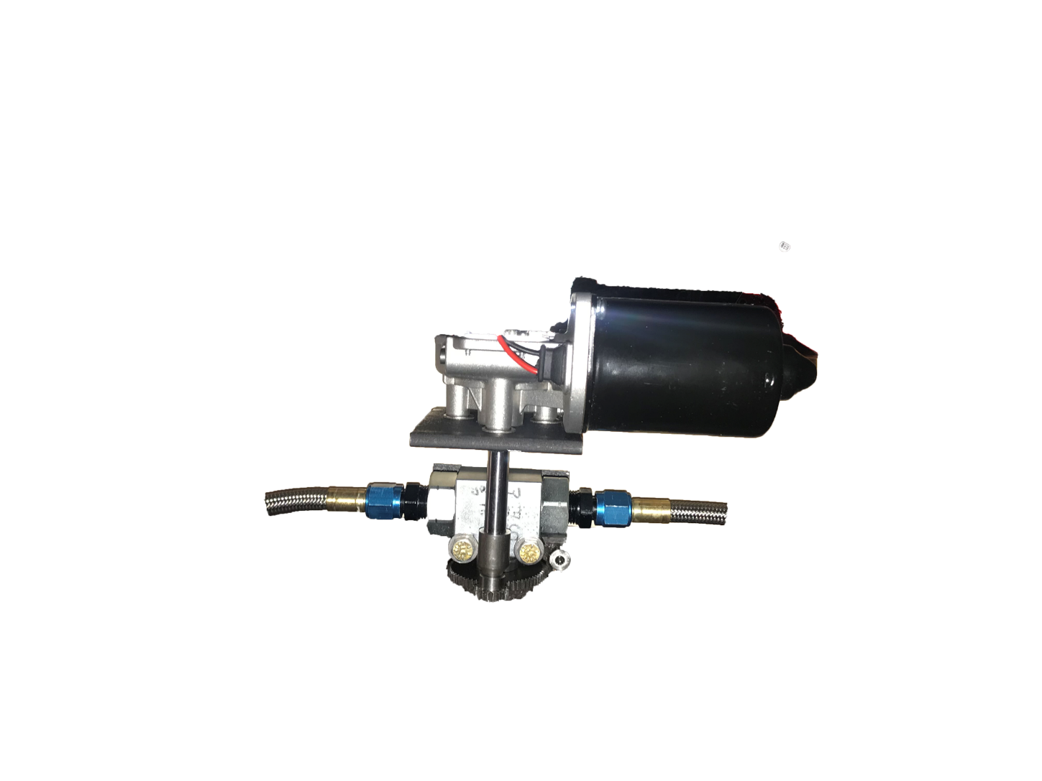
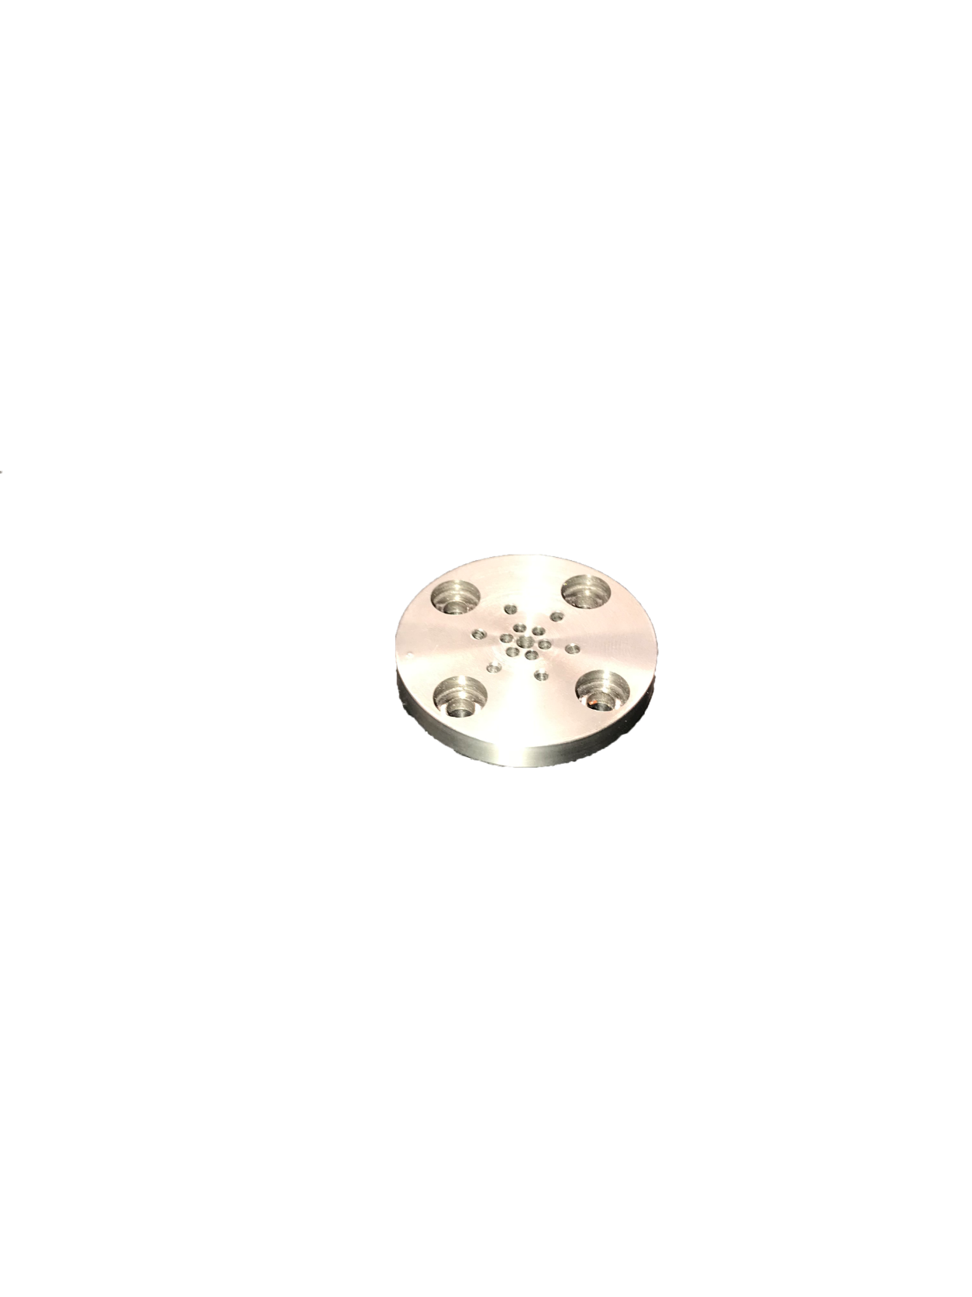
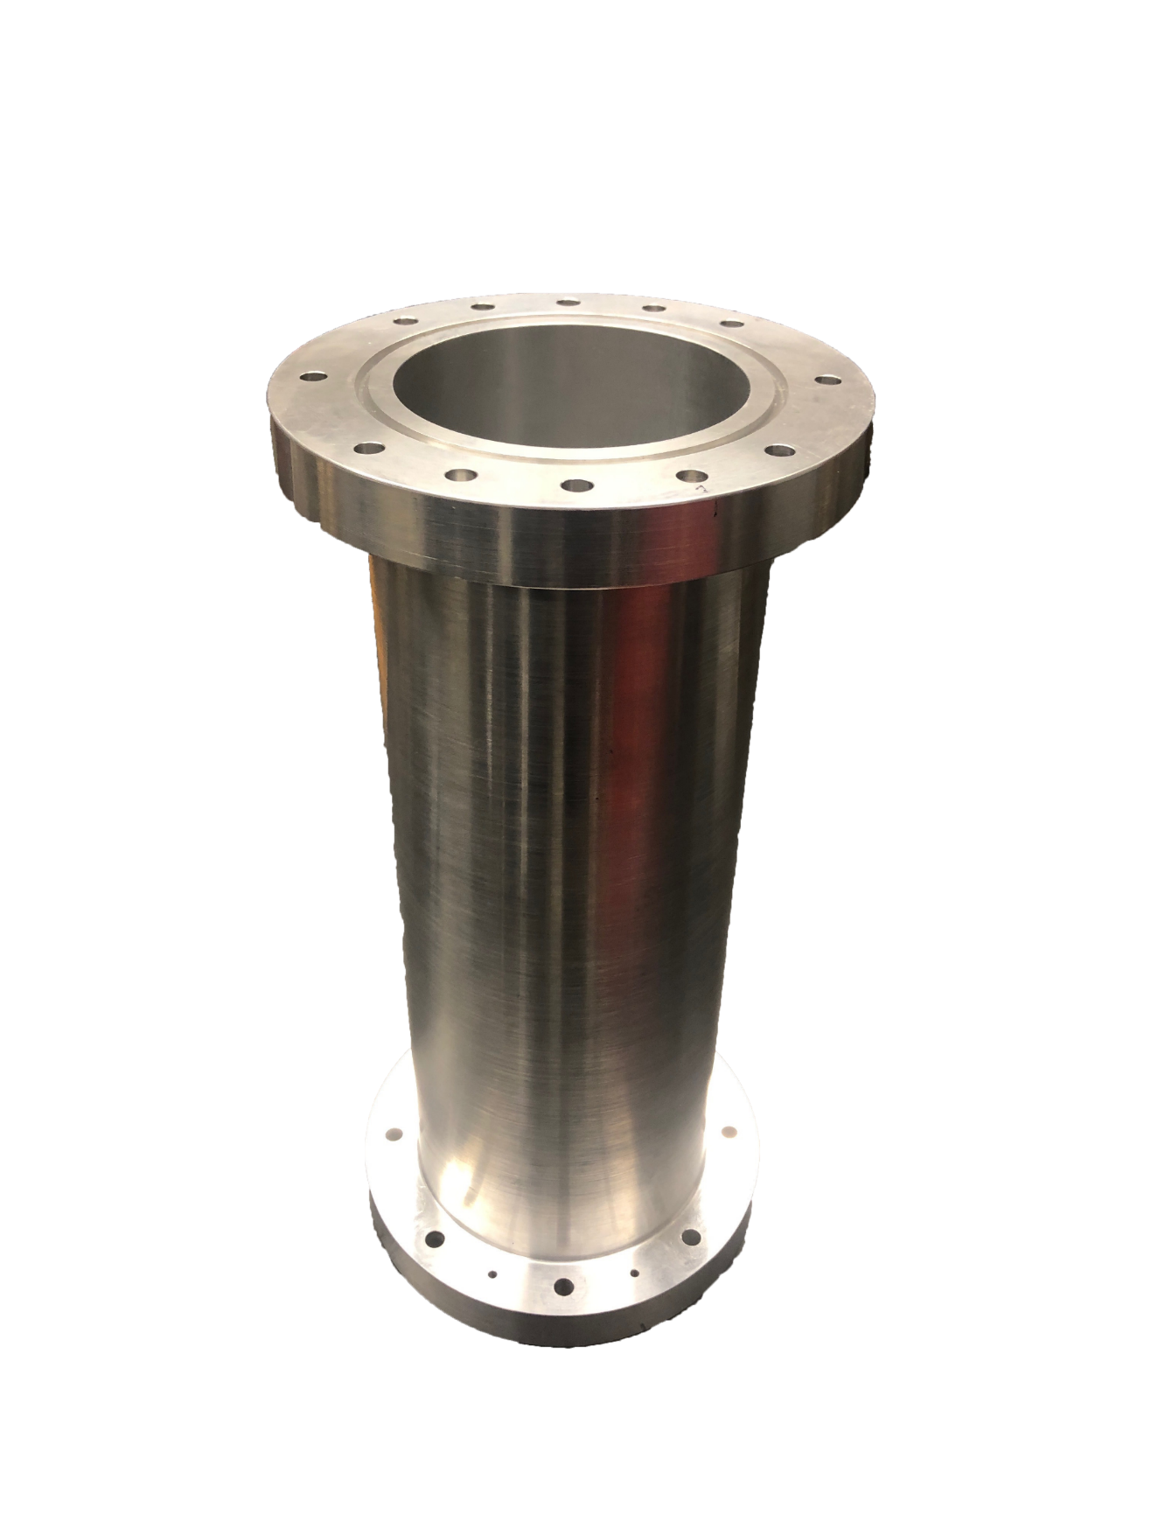
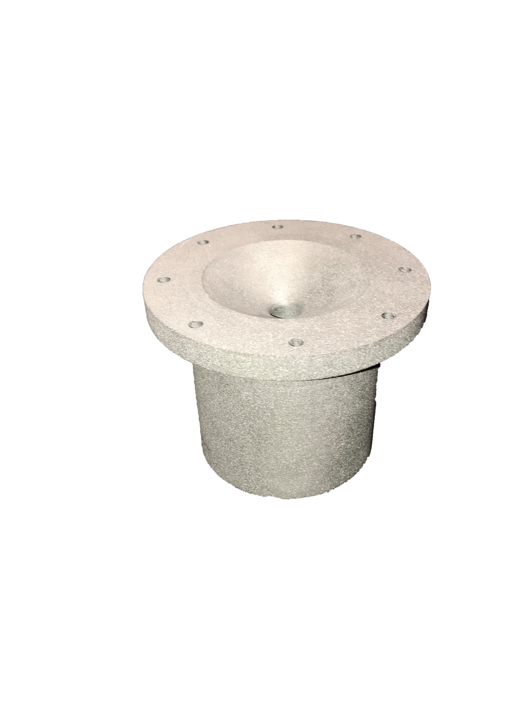
Year 2 Throttle Controlled Rocket Engine Concept

Slide 9
Year 2 Throttle Controlled Rocket Engine Reducer and Oxidizer

Slide 10
Year 2 Throttle Controlled Rocket Engine Oxidizer Flow Control

Slide 11
Year 2 Throttle Controlled Rocket Engine Injector Plate Design

Slide 12
Year 2 Throttle Controlled Rocket Engine Combustion Chamber Design

Slide 13
Year 2 Throttle Controlled Rocket Engine Nozzle Design

Slide 14
Year 2 Throttle Controlled Rocket Engine Component Manufacturing

Slide 15
Year 2 Throttle Controlled Rocket Engine Cold Test - Injector

Slide 16
Year 2 Throttle Controlled Rocket Engine Safety - Hot Fire Test

Slide 17
Year 2 Throttle Controlled Rocket Engine Data Collection - Hot Fire Test

Slide 18
Year 2 Throttle Controlled Rocket Engine Moving Forward

Slide 19
Year 3 Competition Rocket for Spaceport Goals

Slide 20
Questions?
Charlie Nitschelm
cjn1012@wildcats.unh.edu
unhseds.org
(Coming March 2019)

